Slide 1
Cozmo Soar Interface

Slide 2




Installation

Slide 3
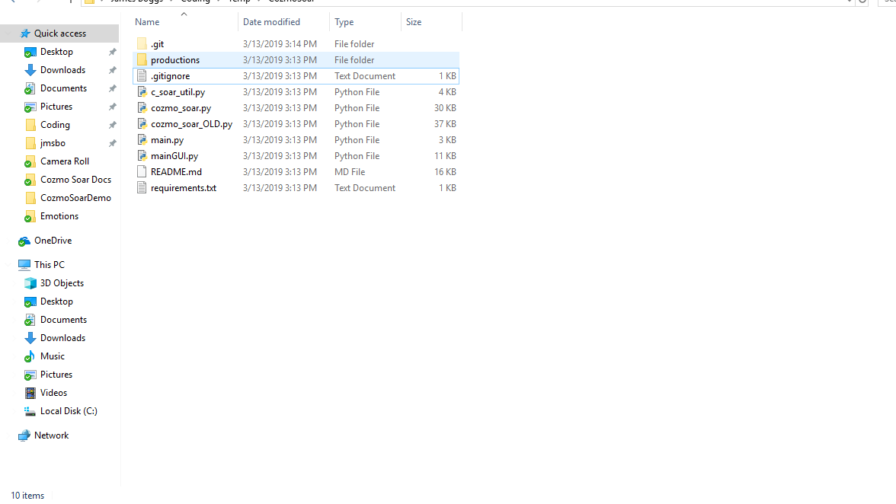
Clone CozmoSoar
https://github.com/JBoggsy/CozmoSoar

Slide 4
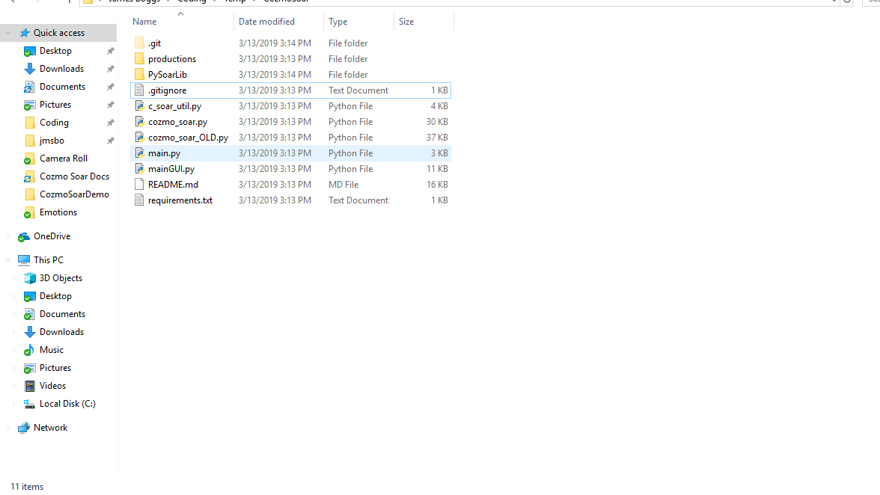
Clone PySoarLib
https://github.com/amininger/pysoarliB

Slide 5
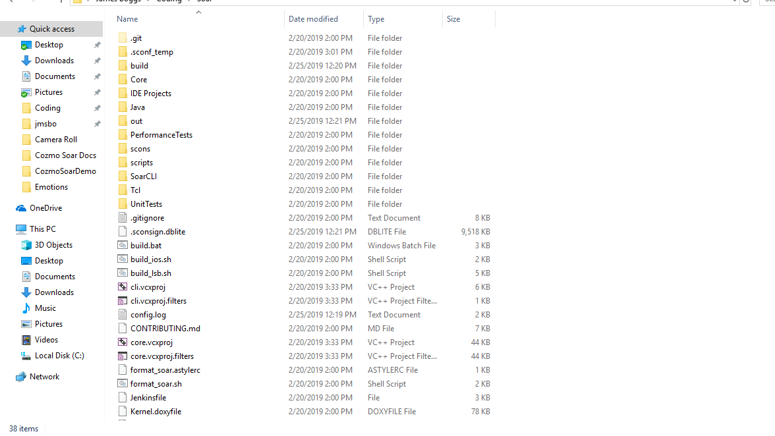
Find Soar Installation
Copy “Out” Folder

Slide 6
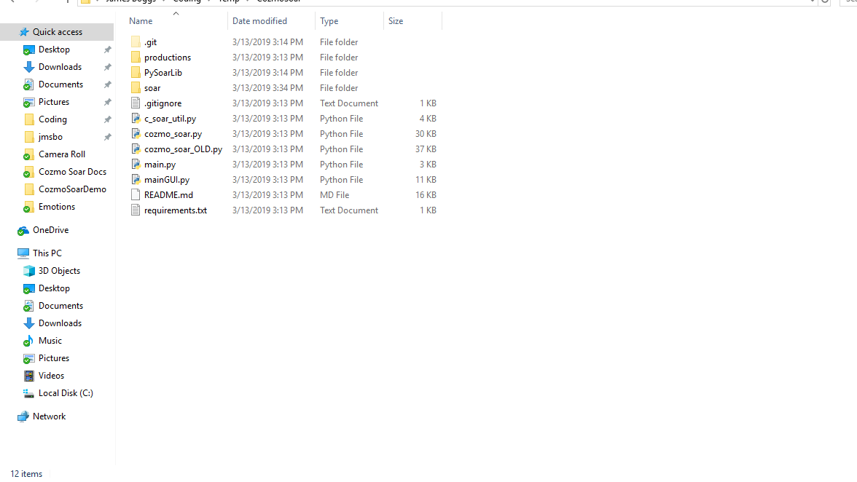
Paste to Root
Rename to “soar”

Slide 7
Install Python Requirements
Python 3.6+
pip install cozmo

Slide 8
Input Link
(I2 ^battery-voltage 4.207947
^carrying-block 0
^carrying-object-id -1
^charging 0
^cliff-detected 0
^face F1
^face-count 1
^head-angle 0.092110
^lift L2
^object O8
^object-count 0
^picked-up 0
^pose P1
^robot-id 1
^serial 08822f79
^time T1)

Slide 9
Face/Object Augmentations
(O8 ^connected True
^cube-id 3
^object-id 2
^descriptive-name |LightCube 3 id=2|
^liftable 1
^moving False
^type cube
^pose P4)
(F1 ^exp-score 54
^expression angry
^face-id 1
^name unknown
^pose P3)

Slide 10
Other Augmentations
(P1 ^rot 18.525771
^x 0.101653
^y 1.588267
^z 0.192416)
(L2 ^angle -0.207360
^height 31.412085
^ratio -0.009799)
(T1 ^seconds 30
^steps 6)

Slide 11
Cozmo Actions
dock-with-cube
object-id (int)
drive-forward
distance (float)
speed (float)
go-to-object
object-id (int)
move-head
angle (float)
move-lift
height (float)
pick-up-object
object-id (int)
place-object-down
set-backpack-lights
color (str)
turn-in-place
angle (float)
speed (float)
turn-to-face
face-id (int)

Slide 12
Output Link
(I3 ^move-head V2 ^move-lift V1)
(V2 ^angle 0.000000)
(V1 ^height 0.000000)

Slide 13
Output Link
(I3 ^move-head V2 ^move-lift V1)
(V2 ^angle 0.000000 ^status running)
(V1 ^height 0.000000 ^status running)

Slide 14
Output Link
(I3 ^move-head V2 ^move-lift V1)
(V2 ^angle 0.000000 ^status complete)
(V1 ^height 0.000000 ^status complete)

Slide 15
Output Link
(I3 ^move-head V2 ^move-lift V1)
(V2 ^angle 0.000000 ^status complete)
(V1 ^height 0.000000 ^status complete)

Slide 16
Output Link
(I3 ^turn-in-place A9)
(A9 ^angle -55.030029
^speed 45
^status running)

Slide 17
Output Link
(I3 ^move-head V2 ^move-lift V1)
(V2 ^angle 0.000000 ^status complete)
(V1 ^failure-code tracks_locked
^failure-reason |Action failed due to tracks locked|
^height 0.000000
^status failed)

